Slide 1

Introduction to
Lecturer: Thomas Laur
User of Subversion

Slide 2

Sources
Article "Git für Einsteiger: Wie man das Versionskontrollsystem Git nutzt"
Uwe Baumann
https://entwickler.de/dotnet/git-fur-einsteiger-wie-man-das-versionskontrollsystem-git-nutzt
Book "Pro Git"
https://git-scm.com/book/en/v2

Slide 3
Agenda
Short History of Git
User Statistics
Advantages Version Control System
Technical Insights
Pros
Cons
Recommended 3 Steps to migrate

Slide 4
Short History of Git
1991-2002
Linux Community passed changes in the software around as patches and archived file
2002
Linux kernel project used a proprietary DCS called BitKeeper
2005
BitKeeper's free-of-charge status was revoked
Linux Community startet to develop Git
Based on the experiences they had from BitKeeper
Since then developed from an active community

Slide 5
User statistics
Source:
Developer Survey Results 2018
Website: Stackoverflow.com

Slide 6
User statistics
Source:
Developer Survey Results 2018
Website: Stackoverflow.com

Slide 7
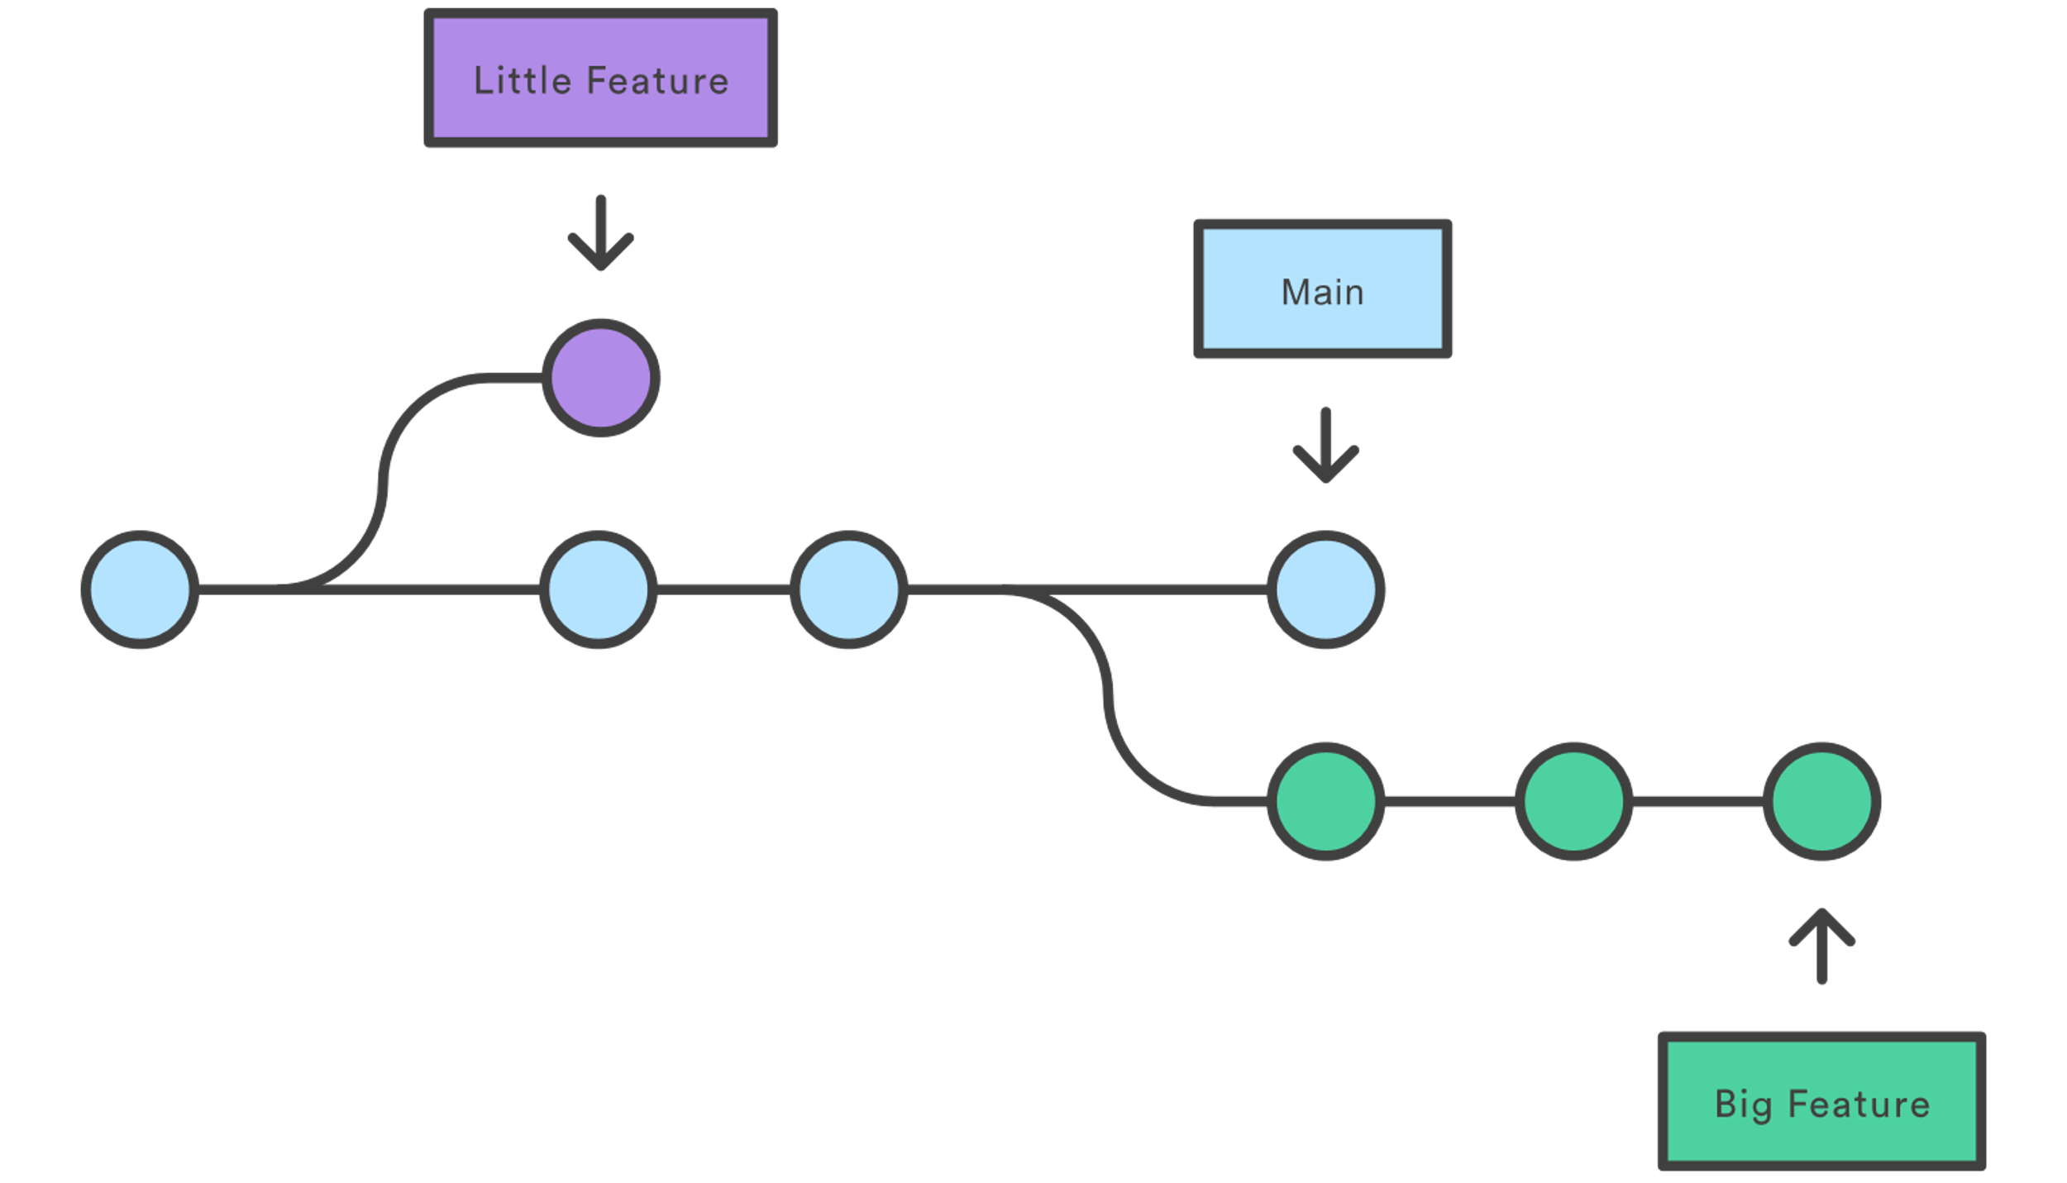
Advantages Version Control System
A comprehensive, long-term change history for each file.
if you screw things up or lose files
You can recover
On a cost of a little overhead
Branching and Merging
Different user can work at the same data
Branch for a new feature or a new Release
Trackability
Tracking of the user, date, purpose of the change
Not only Source Code
For every kind of data

Slide 8
First glance SVN vs. Git Commands
Task | SVN Commands | Git Commands
Create a new repository. | svnadmin create | git init
Copy files into the client workspace. | svn checkout <URL> <target_name> | git clone or git fetch
Send changes to the depot. | svn commit | git commit
Add a new file. | svn import | git add
Compare changes to files. | svn diff | git diff

Slide 9

Git vs TFVC SVN
What is the difference?
Technical Insights

Slide 10
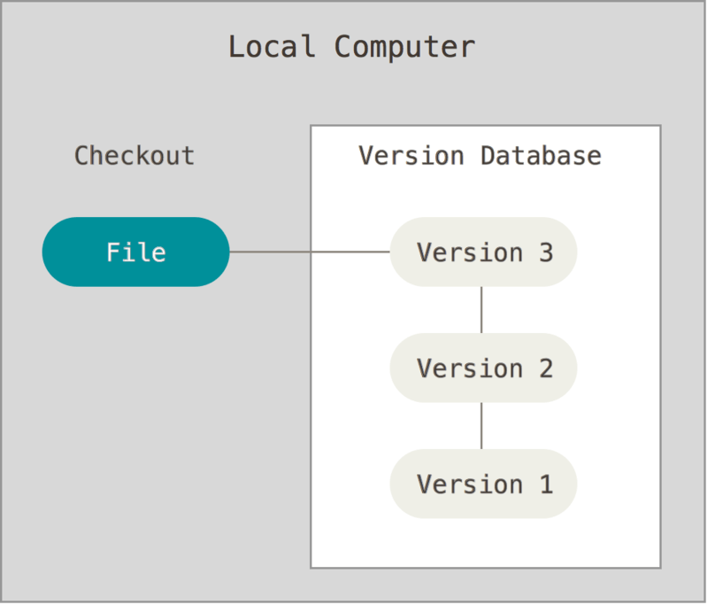
Local Version Control System
Easiest way
Copy files in a different directory
Error prone
Easy to delete or modify the backup files
More advanced
Having a local database
Most popular is RCS
Created in the 80's
Keeps patches to the original file

Slide 11
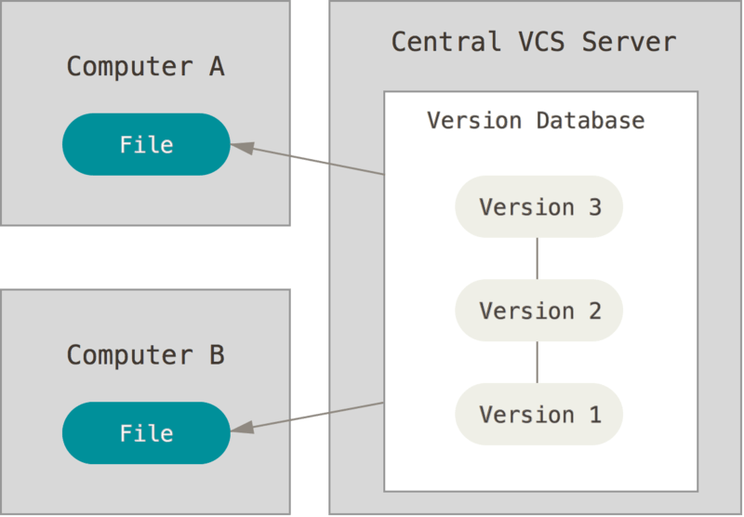


Centralized Version Control System
Answer to the question: How can I collaborate with other developer(s) on a different system?
A server-client system
Single Point-Of-Failure
Database on the server
Depends heavily on network
CVS
Concurrent Versions System

Slide 12
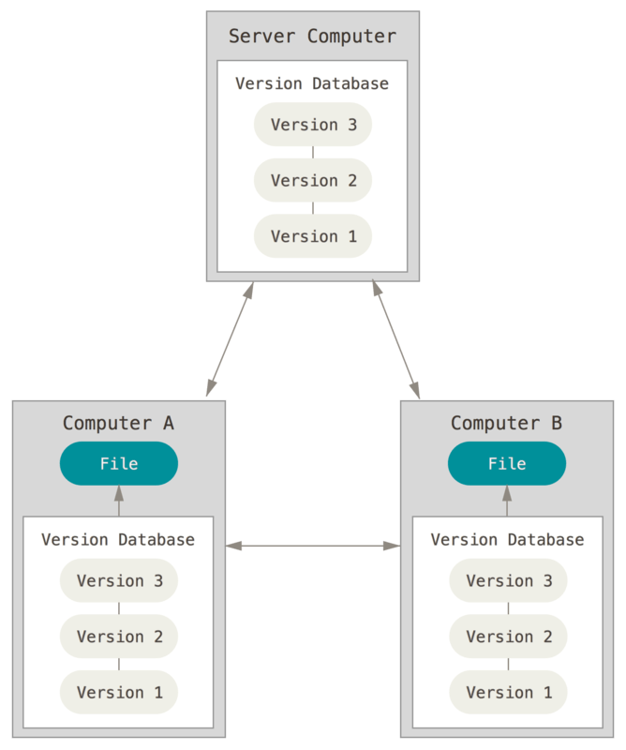


Distributed Version Control Systems
Every time the database is cloned
Every client has the whole database
Including the whole history

Slide 13
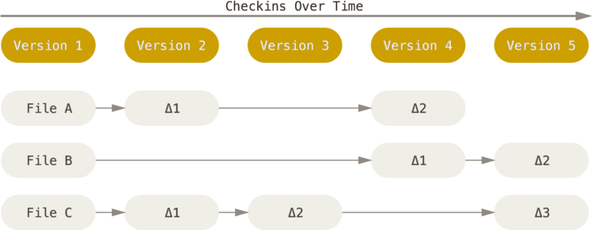
How do VCS save data? delta-based version control
CVS
Concurrent Versions System

Slide 14
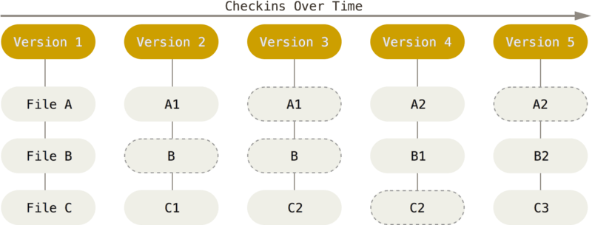
How does Git save data? snapshot-based version control

Slide 15
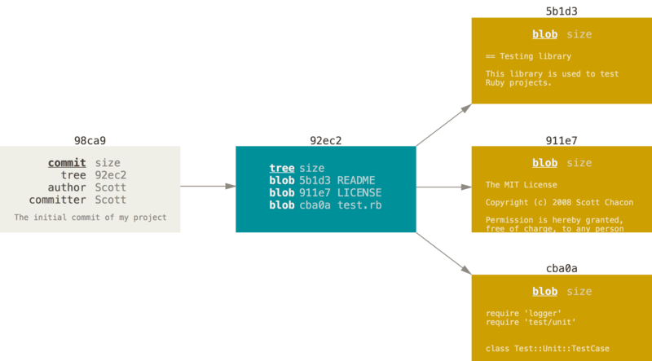
How does Git save a commit?

Slide 16
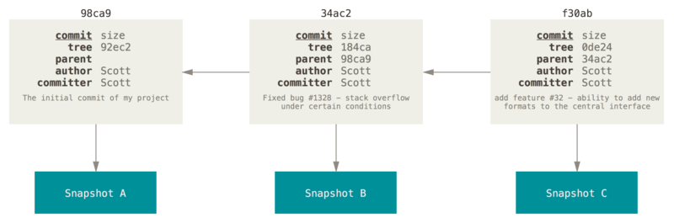
How does Git save a commit?

Slide 17

Git Pros
"Space, the final frontier...."
Star Trek Opening

Slide 18

Pro: Nearly everything is local
generally no information is needed from another computer on your network.
In comparison to a Centralized Version Control System it is totally fast
Advantage if no network is available
In Airplanes
At customer sites
Etc.

Slide 19
Pro: Git has Integrity
Everything is checksummed
Impossible to change the contents of a file without Git knowing about it
Small Input change = Large Output change
Git uses SHA-1 hash function
Lowest levels
Integral to its philosophy
Example:
git cat-file -s 2e8f9e8c26f868b03c9636fa0593479da6ef93f5 [546ms]

Slide 20
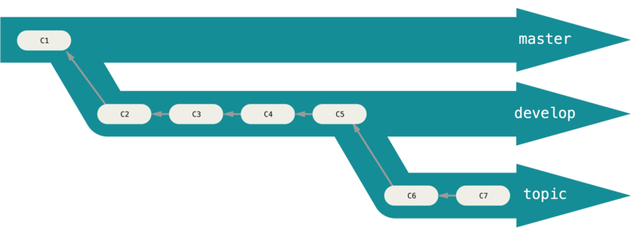
Pro: High flexibility
Changes are in the first step private
more common to use branches
Even in Work
It is common to use own, private branches
Which might be deleted
Far more lower costs

Slide 21
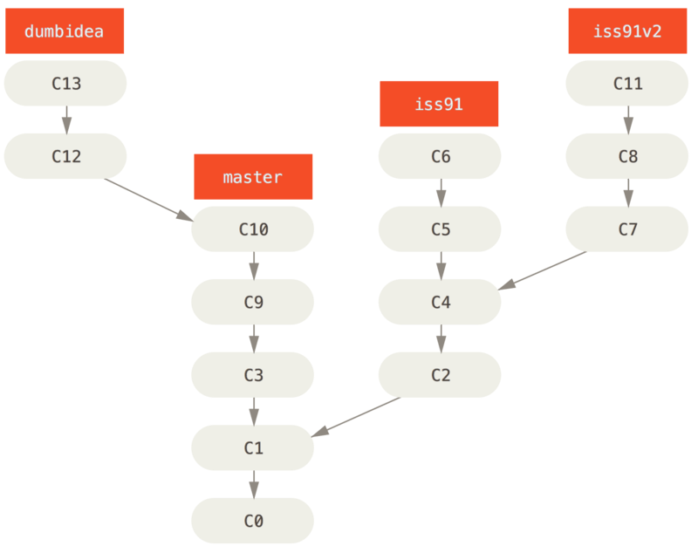
Pro: High flexibility
"Undo on steroids"

Slide 22

Pro: Multi-Platform
Git-Implementations for all important OS's
Everything can be done by CLI
Lots of free or commercial GUI-Clients
Many IDE's has Git integrated
Ideal for Cross-Platform-Developing

Slide 23

Git Cons
"Insufficient facts always invite danger."
Mr. Spock, "Space Seed"

Slide 24

Con: Complexity
Data Modell is very flexible
Increased learning effort to work safe and productiv
Easy to get started
Reaching an barrier
Git has a different behaviour in certain conditions
Than a starter would expect
Data seems to disapear
Git has a "–force" Parameter
To allow certain operations which are normally prohibited

Slide 25

Con: Decentralized
Not suitable for very large monolithic databases
Windows-Team at Microsoft wanted migrate to Git
Monolithic Windows-Sourcecode
3,5 million Files
300 GB Repo-Size
Basic Operations took hours!
Developed Git Virtual File System
GitHub recommends
Reposize < 1GB
Max. Filesize < 100 MB

Slide 26
Git 3 Steps to Migrate
"…. To boldly go where no man has gone before"
Star Trek Opening

Slide 27
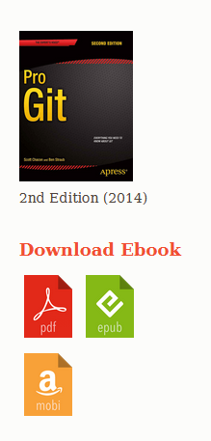
Recommended 3 Steps to Migration Step 1 – Inform and Learn
Starting point
Official Webseite https://git-scm.com/
Book "Pro Git"
Free on the website
https://git-scm.com/book/en/v2/Getting-Started-About-Version-Control
Tutorial on Atlassian Website
https://www.atlassian.com/de/git/tutorials
familiarize yourself intensively with how Git works

Slide 28
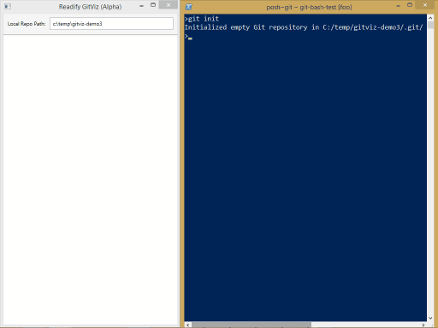
Recommended 3 Steps to Migration Step 2 - Practice
Start with the CLI and a simple Project
Learn basic commands
Use the Tool GitViz
https://github.com/Readify/GitViz
Visualize the internal processes of Git

Slide 29
Recommended 3 Steps to Migration Step 3 - Migration
Git supports
Import of SVN Repos
Import of TFVC Repos
To max 30 days of version history
Manual Migration
Checkout from the old VCS
Checkin in to Git

Slide 30

Thank you for your attention

